Slide 1
Introduction to Machine Learning

Slide 2
Machine Learning Concept

Slide 3

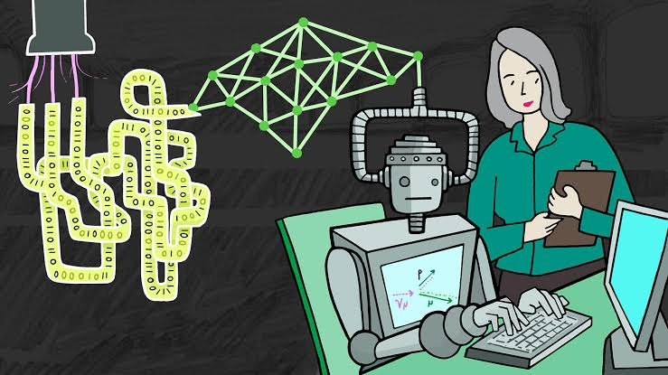
What do you think about machine learning?

Slide 4
Definition of Machine learning
Machine learning is an application of artificial intelligence (AI) that provides systems the ability to automatically learn and improve from experience without being explicitly programmed. Machine learning focuses on the development of computer programs that can access data and use it learn for themselves. That is, it uses mathematical algorithms which end goal is to learn from data and make prediction about similar instance in a new data point.

Slide 5
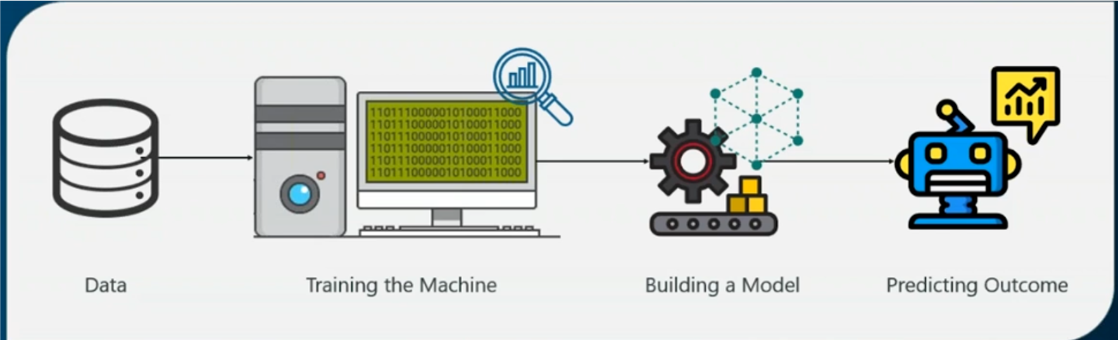
Definition of Machine learning

Slide 6
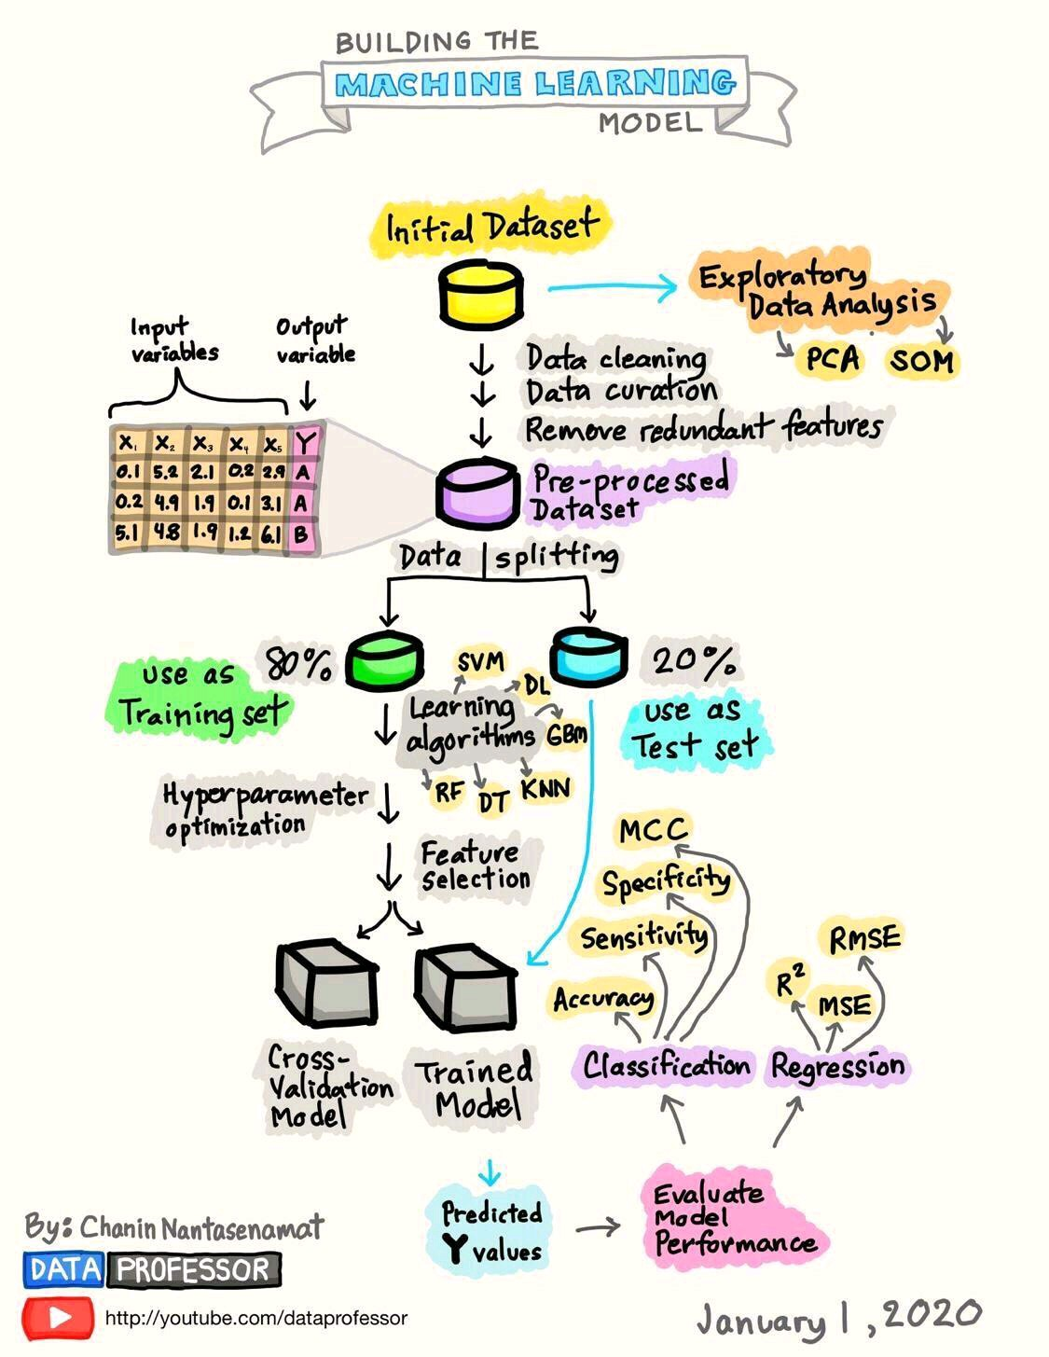
Definition of Machine learning
When else you hear about machine learning, think about this:

Slide 7
Terms in Machine Learning (ML)
The following are some basic concepts which must be defined in machine learning:
Data: Data can be defined as any form of information that can be inputted to a computer
Instance: rows/observations in the dataset

Slide 8
Terms in Machine Learning (ML)
Algorithm: A set of rules and statistical techniques used to learn patterns from data
Model: A model is trained on data by using a machine learning algorithm

Slide 9
Terms in Machine Learning (ML)
Label: It is the output variable that needs to be predicted (i.e. whether the animal is a Dog or a Cat) by using the set of predictors variables known as features
Feature: Attributes of the dataset that can predict the label

Slide 10
Terms in Machine Learning (ML)
Training data: This is the set of dataset that is set apart to train our models. This always contains 80% of the original dataset
Testing data: The trained model(s) needs to be evaluated on the unseen data called test data. This shows the performance of the model(s). It is always 20% of the original dataset

Slide 11
Types of Machine Learning
Machine learning techniques can be implemented in four ways and these include supervised learning, unsupervised learning, semi-supervised learning, and reinforcement learning.

Slide 12
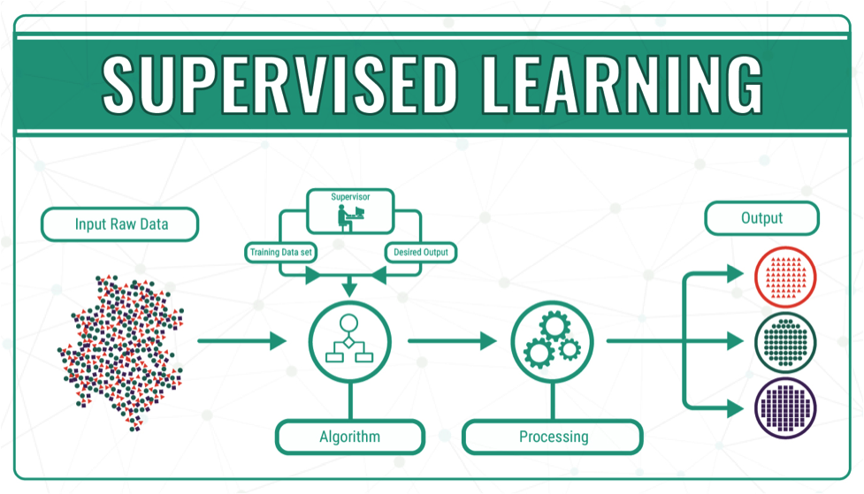
Supervised learning
Supervised learning algorithms consist of a label which is to be predicted from a given set of features. The task is to learn a function that maps an input to an output based on example input-output pairs.

Slide 13
Supervised learning
Common examples of supervised learning include:
classifying e-mail as spam or not spam (inbox)
predicting the housing price based on the attributes of the house
Supervised learning is the most studied and common type of machine learning. Learning with supervision is much easier than learning without supervision.

Slide 14
Type of supervise learning
Supervised learning can be classification or regression.
Classification
A classification (model) is the type of model in which the output variable (i.e. the label) is discrete/categorical. e.g. predict if the patient has cancer or not, if an employee will leave or stay etc. Classification problem is an example of pattern recognition. Machine learning method that implements classification is known as a classifier.

Slide 15
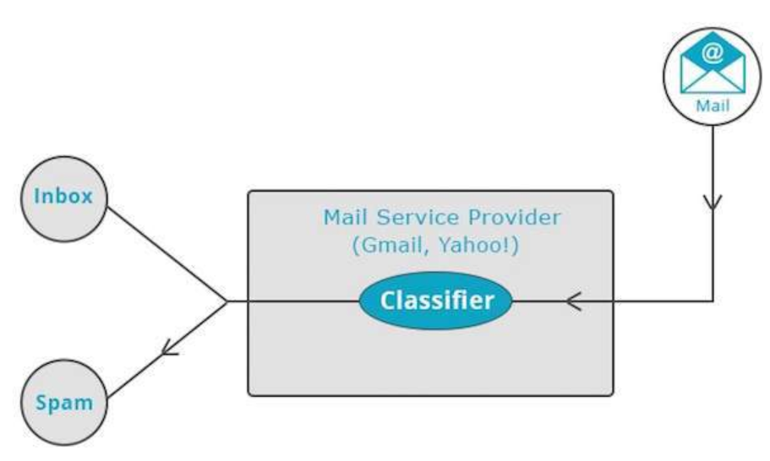
Classification

Slide 16
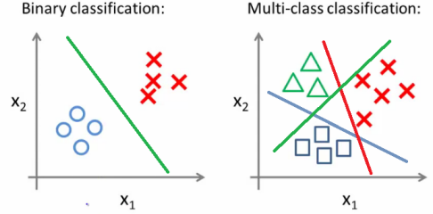
Type Classification

Slide 17
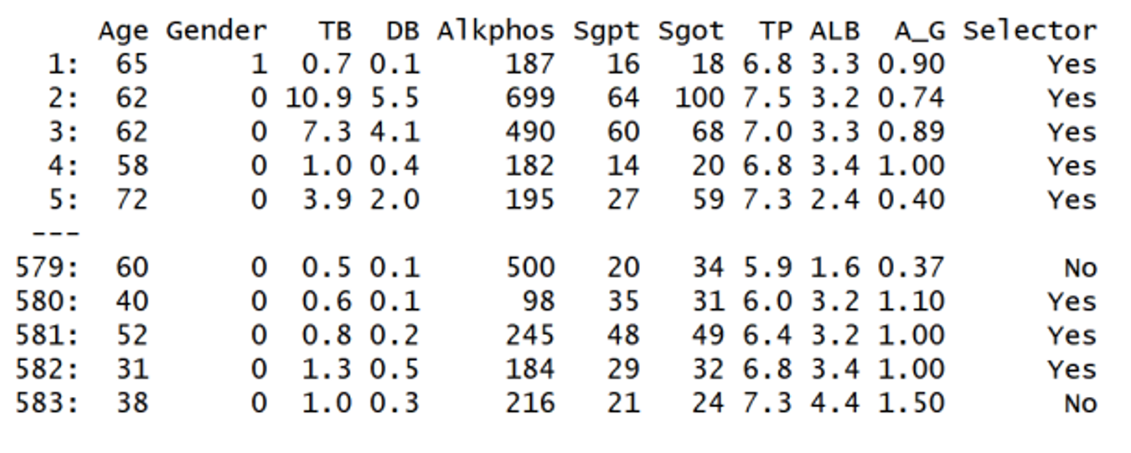
Example 1: Predicting whether patient has liver disease or not
Label: The label for this problem is Selector and it has two classes namely yes or no.

Slide 18
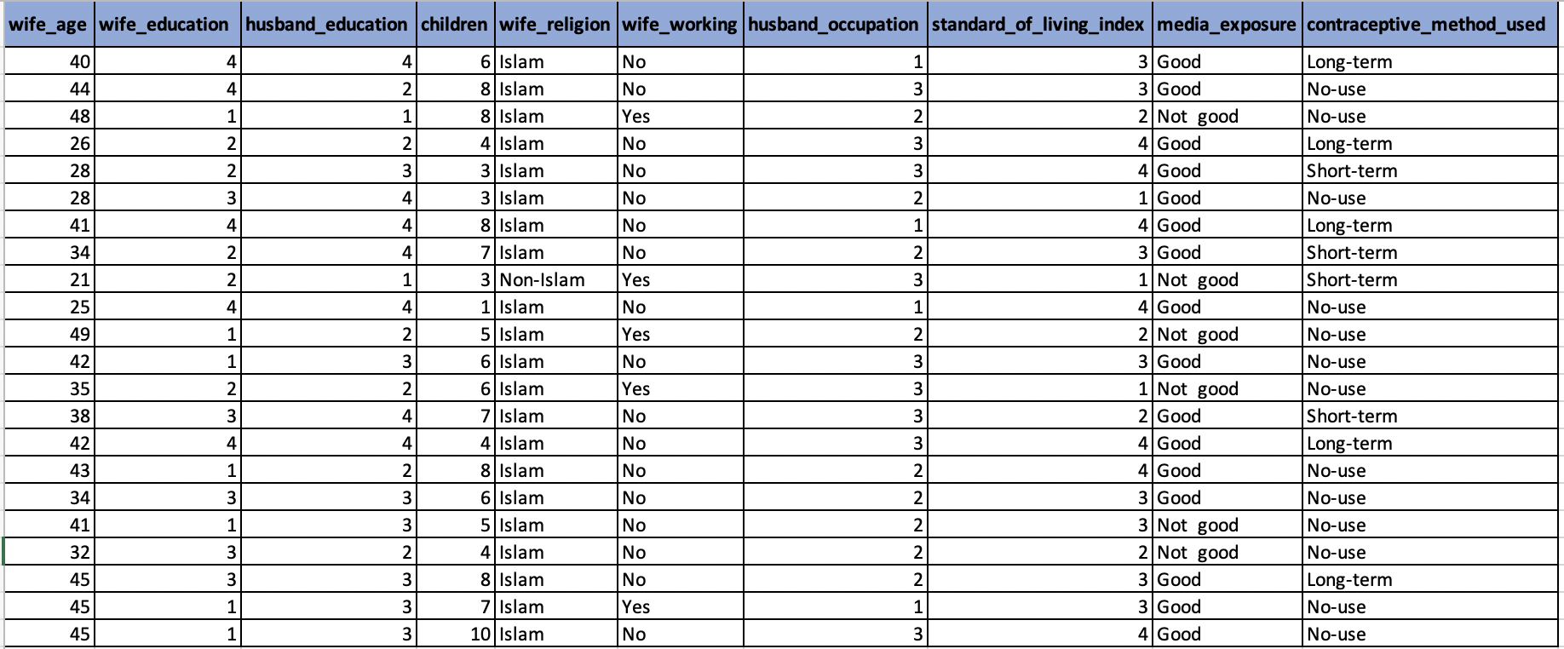
Example 2: Predicting Contraceptive Method Choice in Somalia
Label: The label for this problem is contraceptive method used and it has three classes namely long-term, short-term, or no-use.

Slide 19
Classification models
There are many classification learning algorithms and they include:
Support Vector Machine (SVM)
K- Nearest Neighbour (KNN)
Logistic Regression
Decision Trees
Random Forest
Naive Bayes

Slide 20
Type of supervise learning
Supervised learning can be classification or regression.
Regression
A Regression model is the type of model in which the out variable is continuous e.g. predicting housing price at Mogadishu city in Somalia. Other example includes predicting highest amount of rainfall in Uganda in May 2021.

Slide 21
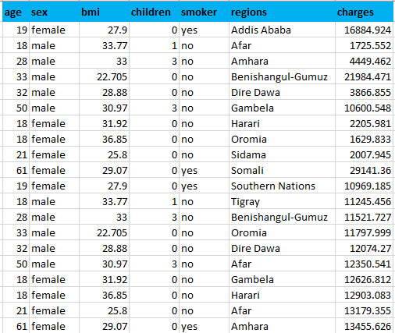
Example 1: Predicting medical insurance charge from the health provider in Ethiopia
Label: The label for this problem is medical insurance charges.

Slide 22
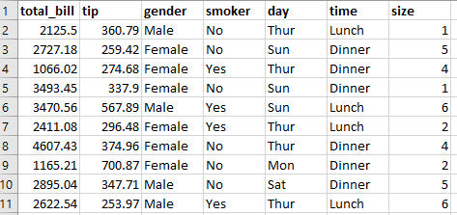
Example 2: Predicting amount of tips given to a food server after a party in the restaurant
Label: The label for this problem is tip

Slide 23
Regression models
There are many regression algorithms and the most common ones are:
Ordinary Least Square (OLS)
Support Vector Machine (SVM)
K- Nearest Neighbour (KNN)
Decision Tree
Random Forest

Slide 24
Unsupervised learning
Unsupervised learning is the training of the model on an unlabeled dataset. That is, there is no information regarding the label in the training dataset. After the model is trained, each new observation is assigned to a cluster of observations with similar characteristics.
Most common application of unsupervised machine learning techniques include Clustering, Factor Analysis (FA), Anomaly detection, Association mining, and Latent variable model (PCA).

Slide 25
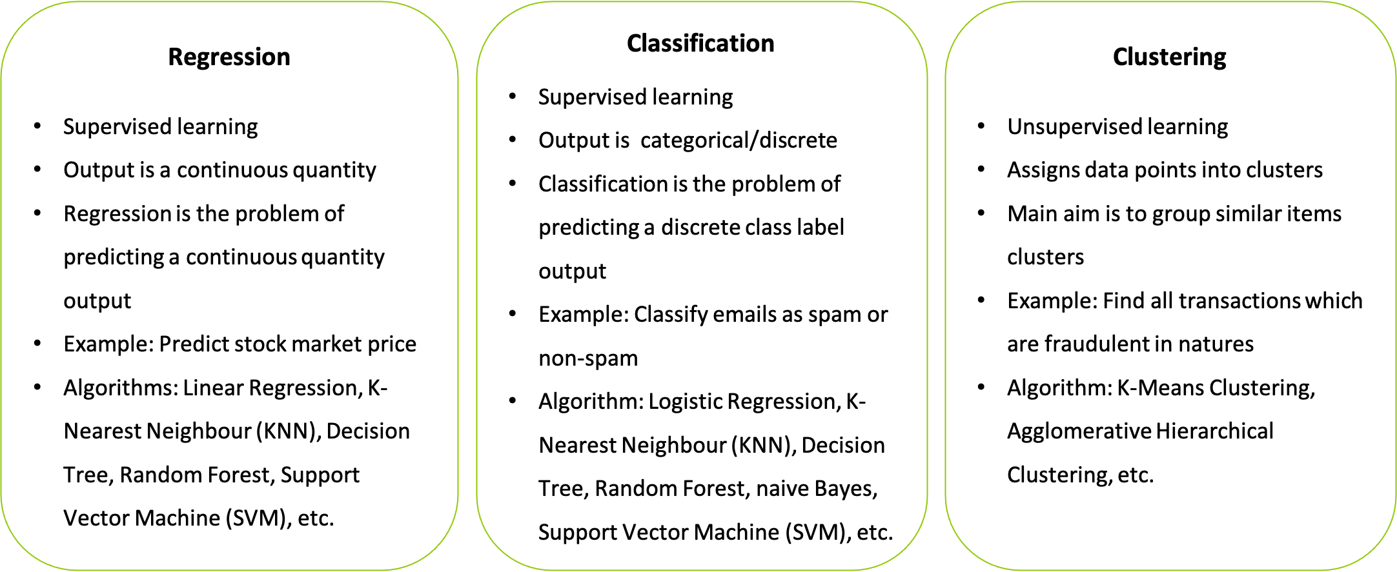
Classification of problems by machine learning

Slide 26


